Slide 1
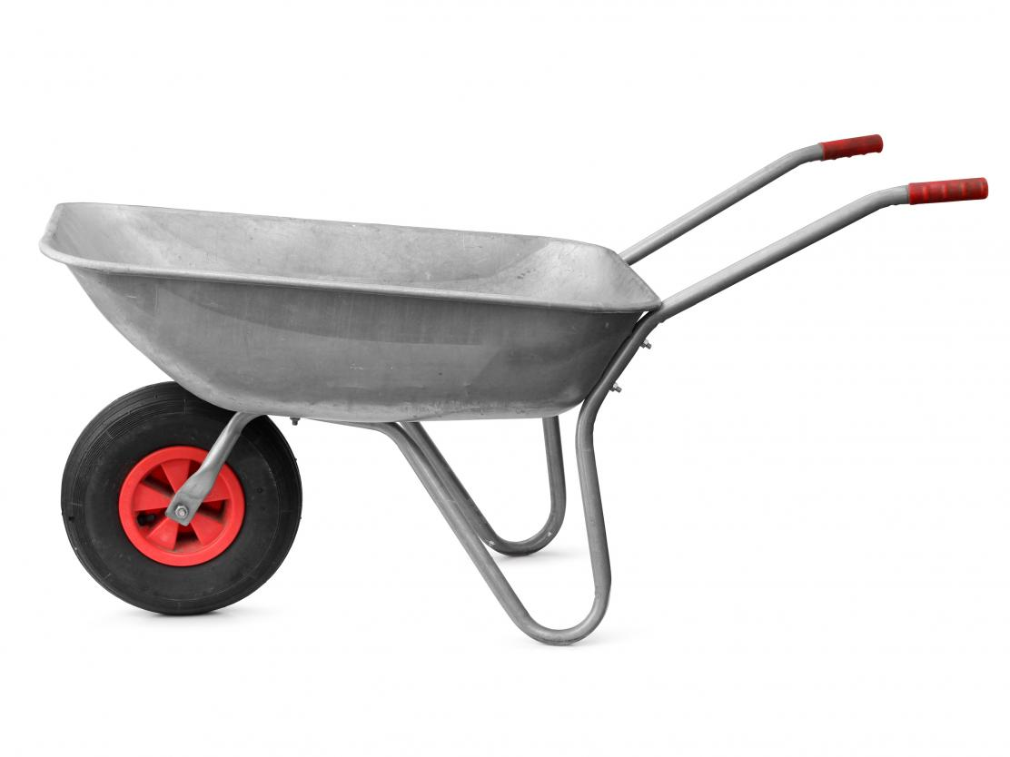
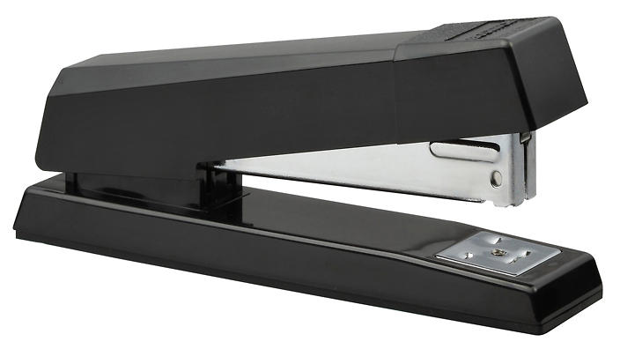
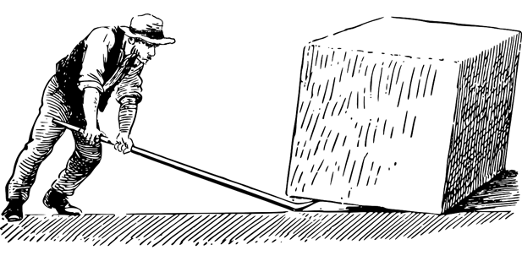
Daily Review
For each of the following levers, label the fulcrum, the input force and the output force.
Vocabulary
fulcrum (noun) the turning point of a lever input force (noun) the force used to operate a lever output force (noun) the force that a lever creates
Notes:
45 s → share → popsticks

Slide 2
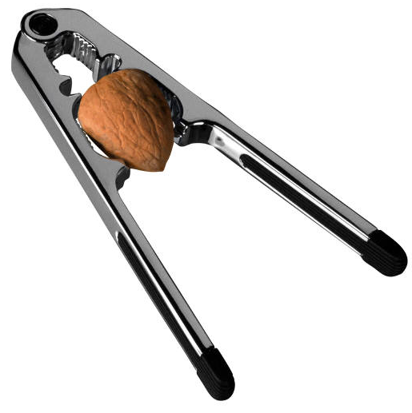
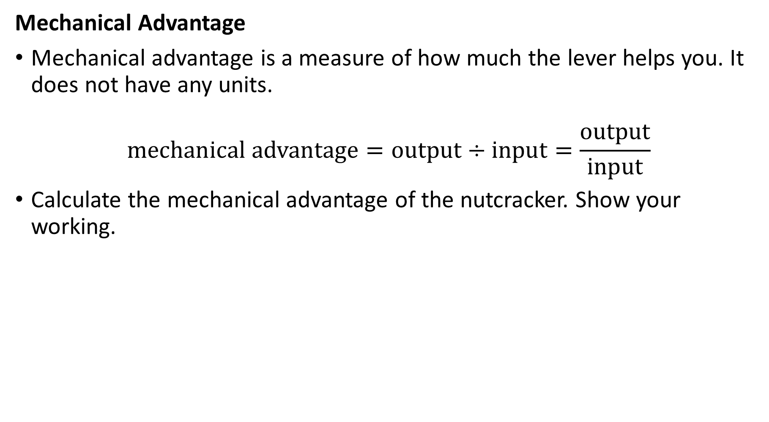
Daily Review
Mechanical Advantage
Mechanical advantage is a measure of how much the lever helps you. It does not have any units.
$$\text{mechanical} \text{advantage}=output÷input=\frac{output}{input}$$
Calculate the mechanical advantage of the nutcracker. Show your working.
output force (160 N)
input force (20 N)

Slide 3
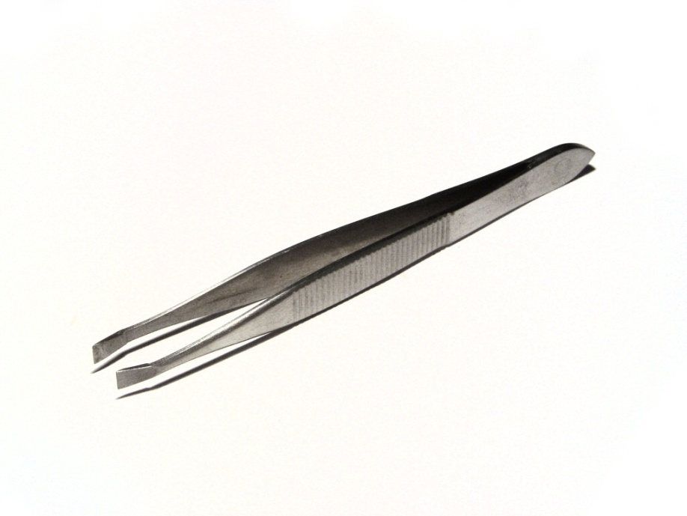
Daily Review
Identifying Levers
Draw the lever on your whiteboard and label the fulcrum, input force and output force.
What class of lever is this? Explain your choice.
The tweezers are a class ______ lever because the _______is positioned in the middle, between the ______ and the _______.
Reminder
FOIL! Class 1: Fulcrum in the middle Class 2: Output force in the middle Class 3: Input force in the middle Levers are easy!

Slide 4
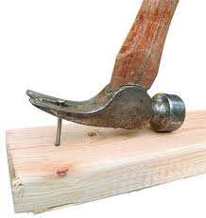
Daily Review
Identifying Levers
Draw the lever on your whiteboard and label the fulcrum, input force and output force.
What class of lever is this? Explain your choice.
The hammer is a class ______ lever because the _______is positioned in the middle, between the ______ and the _______.
Reminder
FOIL! Class 1: Fulcrum in the middle Class 2: Output force in the middle Class 3: Input force in the middle Levers are easy!

Slide 5

Daily Review
Identifying Levers
Draw the lever on your whiteboard and label the fulcrum, input force and output force.
What class of lever is this? Explain your choice.
The fishing rod is a class ______ lever because the _______is positioned in the middle, between the ______ and the _______.
Reminder
FOIL! Class 1: Fulcrum in the middle Class 2: Output force in the middle Class 3: Input force in the middle Levers are easy!

Slide 6
Simple Machines: Inclined Planes Year 7 Science

Slide 7

Learning Objectives
CFU 1
What two things do you need to describe about inclined planes?
Describe what inclined planes do and how they work.
Calculate the mechanical advantage of ramps.
CFU 2
What do you need to be able to calculate?
Activate Prior Knowledge
Ramps are used in many places in our community.
Think, Pair, Share:
List three places where you have used a ramp.

Slide 8
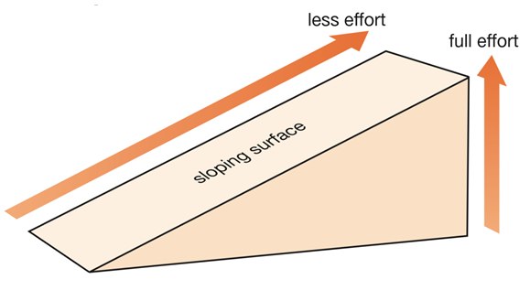
Concept Development
CFU 1
What is an inclined plane?
Inclined Planes
An inclined plane is a simple machine that reduces the input force needed to lift something (i.e. it provides a mechanical advantage).
It does this by increasing the distance over which the force acts.
The most common type of inclined plane is a ramp.
CFU 2
How do inclined planes work?

Slide 9
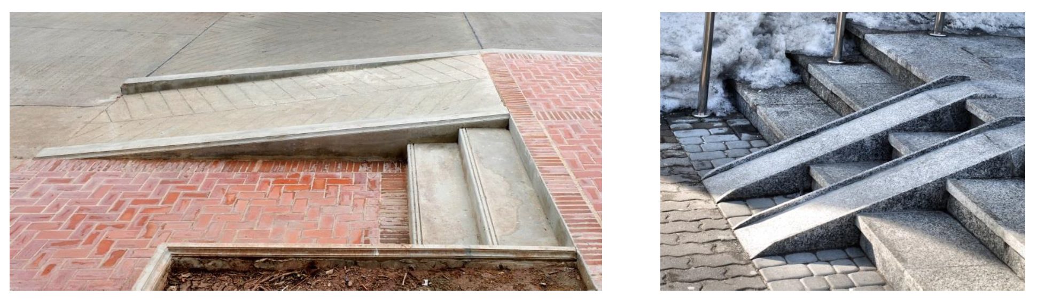
Concept Development
CFU 1
How do ramps make climbing easier?
Ramps
A ramp is an inclined plane used to help lift an object.
Ramps make climbing easier by reducing the input force needed.
They do this by making an object travel over a longer distance.
CFU 2
Think, Pair, Share: Which ramp would be easier to walk up? Why?
CFU 3
Think, Pair, Share: Where else have you used a ramp?
Reminder
An inclined plane works by increasing the distance that the force acts on.

Slide 10
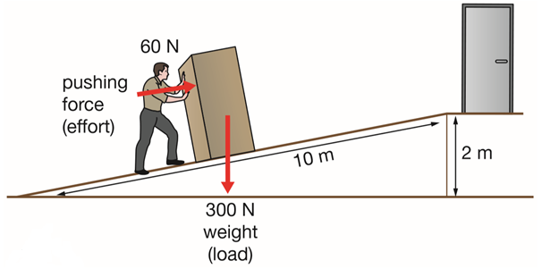
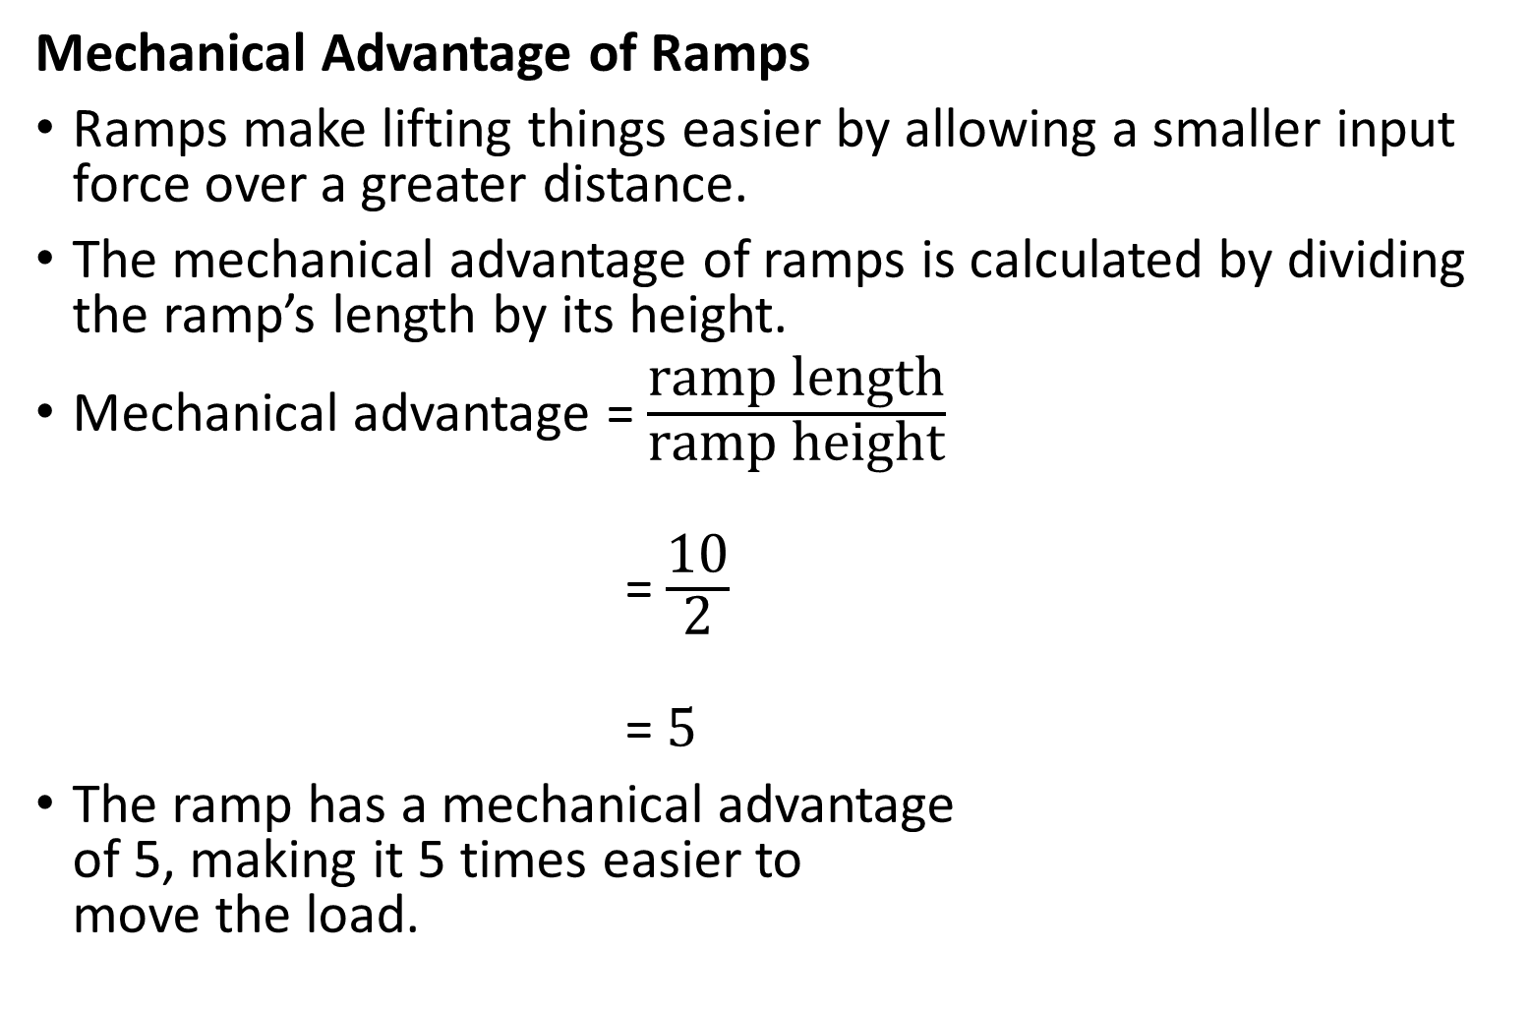
Concept Development
CFU 1
What information do we need to calculate the mechanical advantage of a ramp?
Mechanical Advantage of Ramps
Ramps make lifting things easier by allowing a smaller input force over a greater distance.
The mechanical advantage of ramps is calculated by dividing the ramp’s length by its height.
Mechanical advantage = $\frac{\text{ramp} \text{length}}{\text{ramp} \text{height}}$
= $\frac{\text{10}}{\text{2}}$
= 5
The ramp has a mechanical advantage of 5, making it 5 times easier to move the load.
CFU 2
What is this ramp’s mechanical advantage?

Slide 11
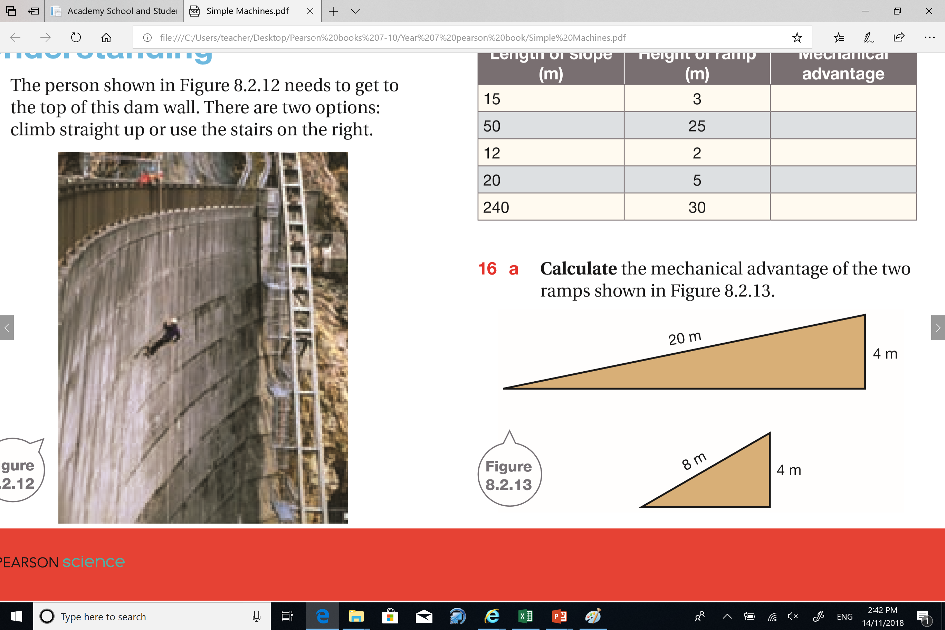
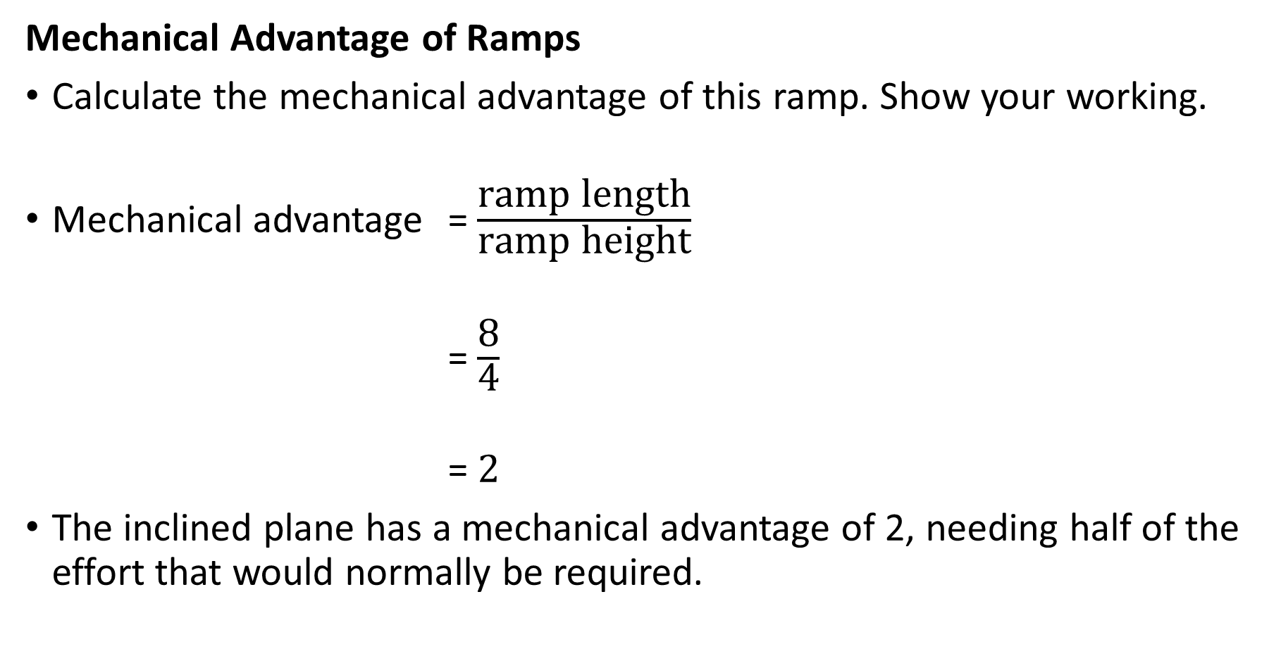
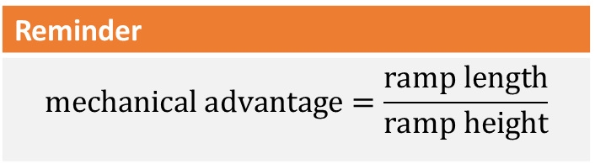
Skill Development / Guided Practice
Mechanical Advantage of Ramps
Calculate the mechanical advantage of this ramp. Show your working.
Mechanical advantage = $\frac{\text{ramp} \text{length}}{\text{ramp} \text{height}}$
= $\frac{\text{8}}{\text{4}}$
= 2
The inclined plane has a mechanical advantage of 2, needing half of the effort that would normally be required.
Reminder
$$\text{mechanical} \text{advantage}=\frac{\text{ramp} \text{length}}{\text{ramp} \text{height}}$$

Slide 12
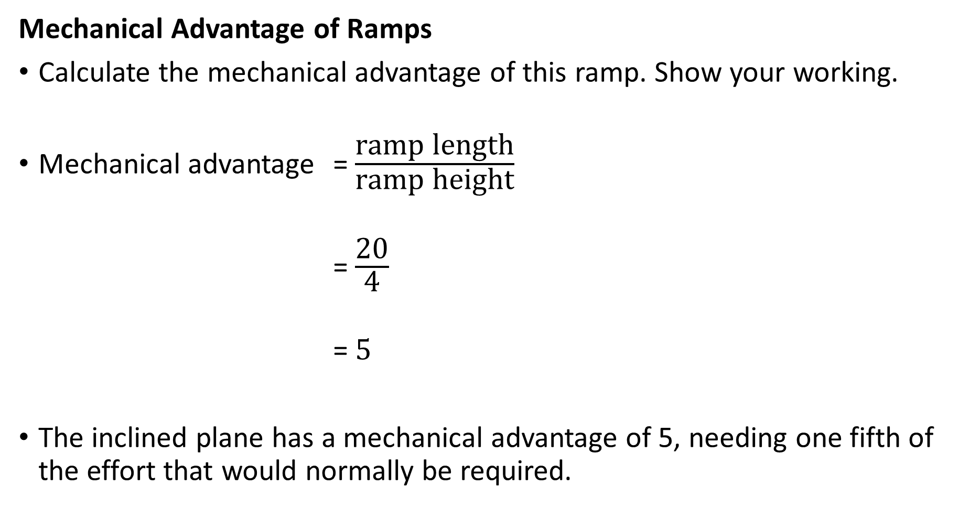
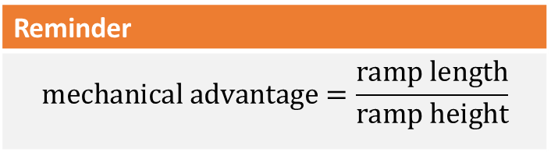
Skill Development / Guided Practice
Reminder
$$\text{mechanical} \text{advantage}=\frac{\text{ramp} \text{length}}{\text{ramp} \text{height}}$$
Mechanical Advantage of Ramps
Calculate the mechanical advantage of this ramp. Show your working.
Mechanical advantage = $\frac{\text{ramp} \text{length}}{\text{ramp} \text{height}}$
= $\frac{\text{20}}{\text{4}}$
= 5
The inclined plane has a mechanical advantage of 5, needing one fifth of the effort that would normally be required.

Slide 13
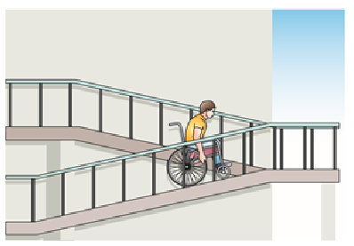
Relevance
As you’ve already seen, inclined planes are used a lot in everyday life.
Knowing how to use inclined planes can make your life much easier!
Ramps are used in buildings for access, to make moving loads easier, and in even on roads.

Slide 14
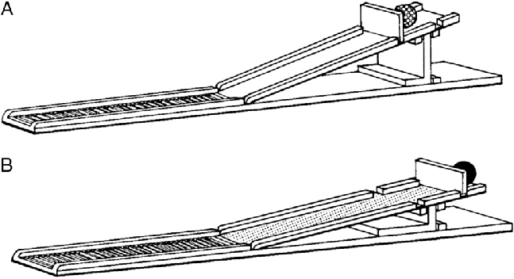
Skill Closure
True or False? The longer the slope of a ramp for a certain height, the greater its mechanical advantage.
Calculate the mechanical advantage of a ramp that is 100 m long and 20 m high.
The two ramps on the right are the same length. Which one provides more mechanical advantage? How do you know?

Slide 15
Independent Practice
Copy the table below and calculate the mechanical advantage of ramps with the dimensions listed.
Length of Slope (m) | Height of Ramp (m) | Mechanical Advantage
15 | 3
50 | 25
12 | 2
20 | 5
240 | 30

